Slide 1



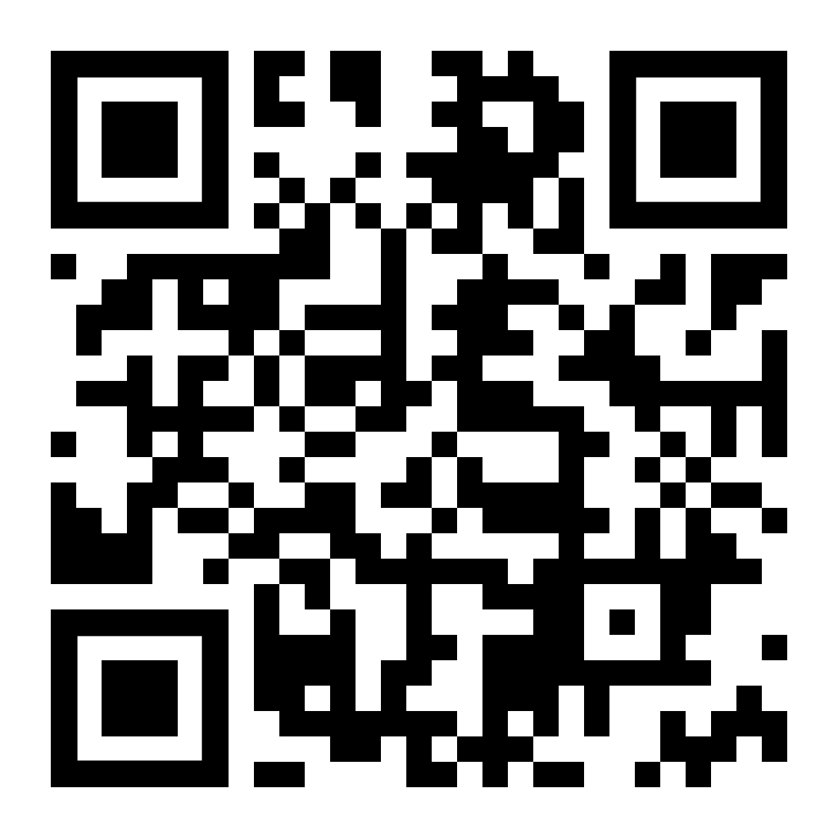



DEVELOPING MULTI-TENANT APPLICATIONS WITH .NET & ABP FRAMEWORK
Follow me on X (Twitter)
Halil İbrahim KALKAN
Co-founder & Lead Architect at Volosoft
hibrahimkalkan
hikalkan

Slide 2

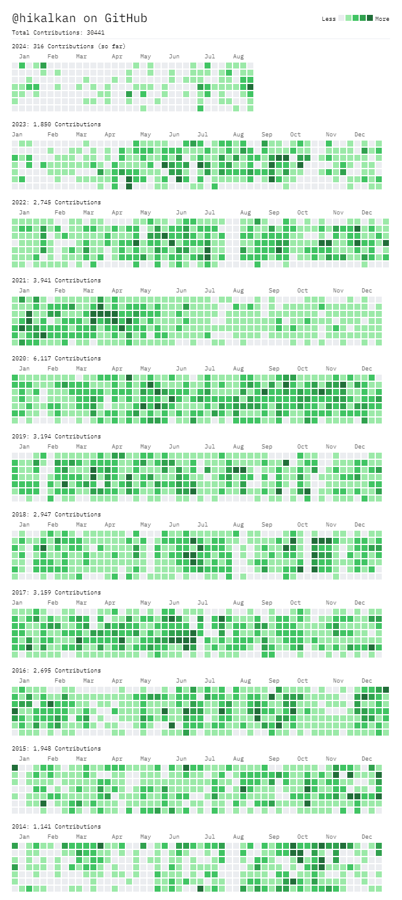







ABOUT ME: HALİL İBRAHİM KALKAN
1997, Started programming (at 14 years old, with Turbo Pascal)
2003-2007, Computer Engineering
2007 - 2015: Software developer, software architect, team leader
2013 - ∞: Lead developer of the open source ABP Framework
2016 - ∞: Co-founder, software architect
Multi-threading, distributed/microservice systems, OOP, DDD, software architectures.. etc.
Still active coder, open-source contributor
30,000+ total contributions on GitHub

Slide 3
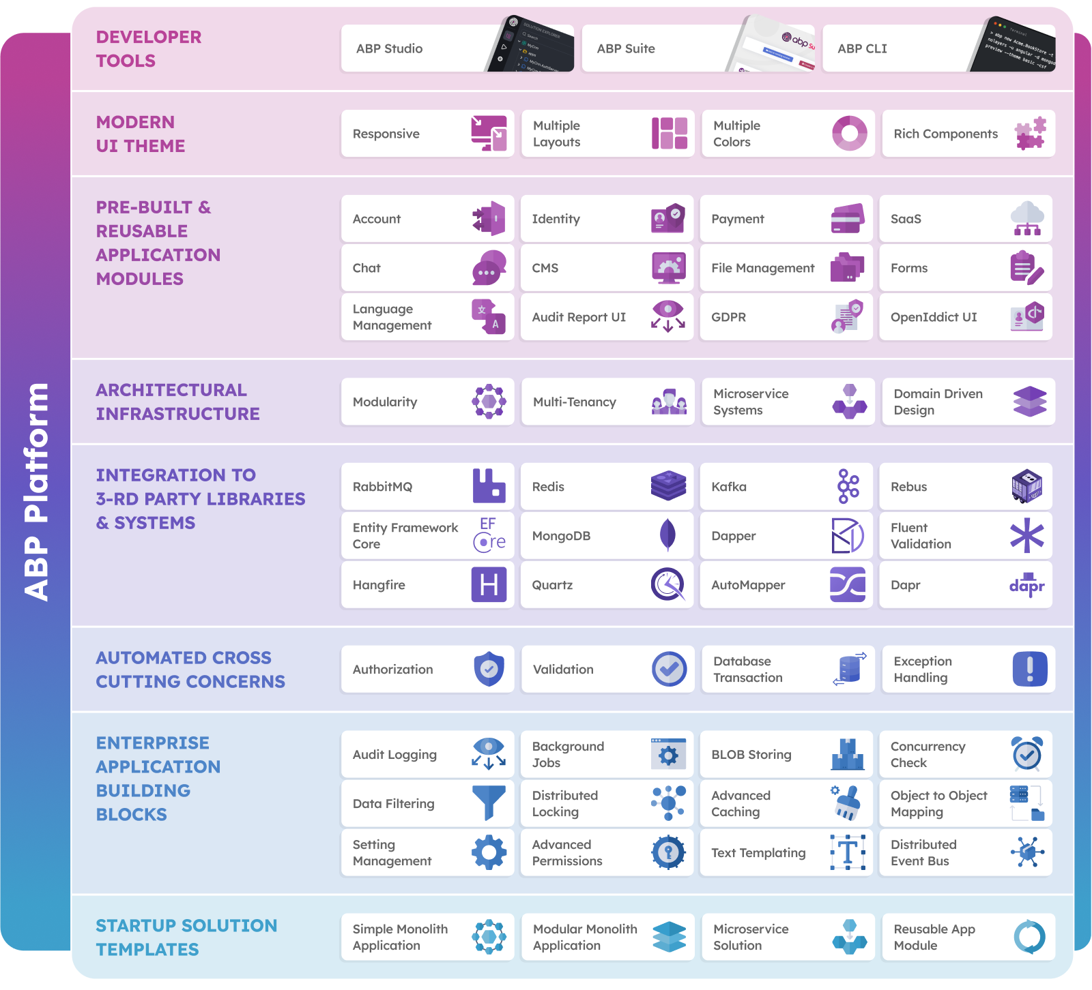

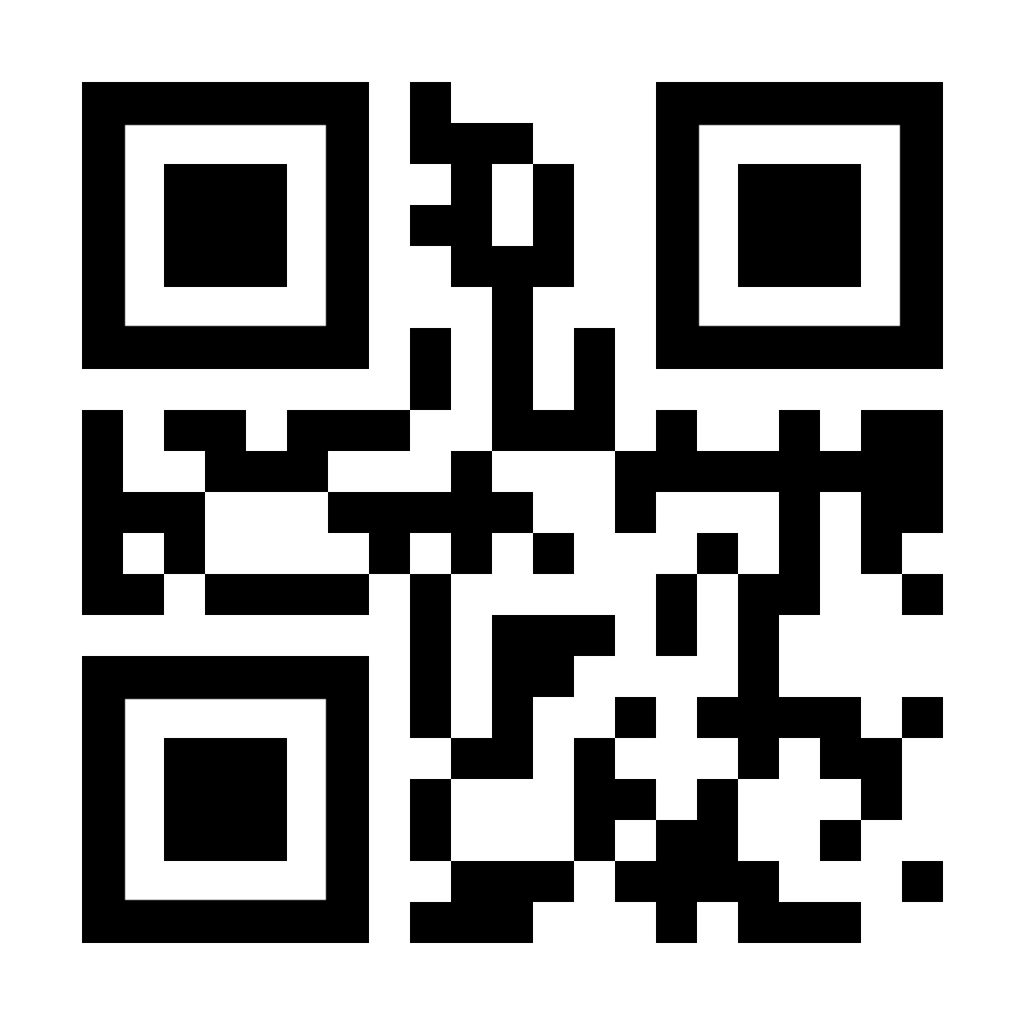
THE ABP PLATFORM
https://github.com/abpframework
https://abp.io

Slide 4
AGENDA
...

Slide 5
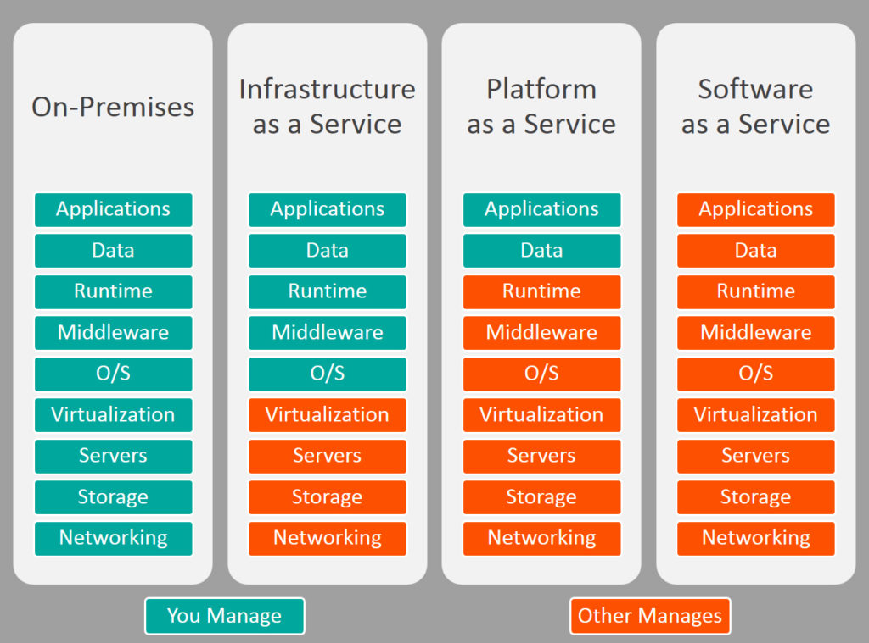

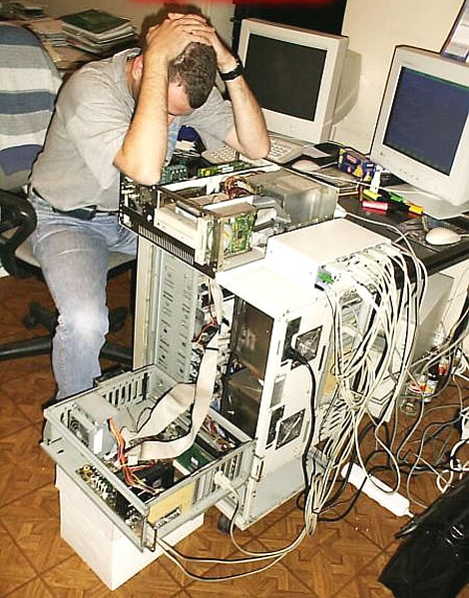
ON-PREMISES → SAAS

Slide 6
WHAT IS MULTI-TENANCY?
Sharing hardware and software resources among multiple customers
Hardware: CPU, RAM, ...
Software: OS, Runtime, Database, ...
Pros
Maximum Utilization / Low Costs
Easy to add a new client (tenant)
All clients use the same application version: Easy to maintain
Cons
Data Isolation
Performance sharing
Configuration & customization
Backup (per tenant)

Slide 7
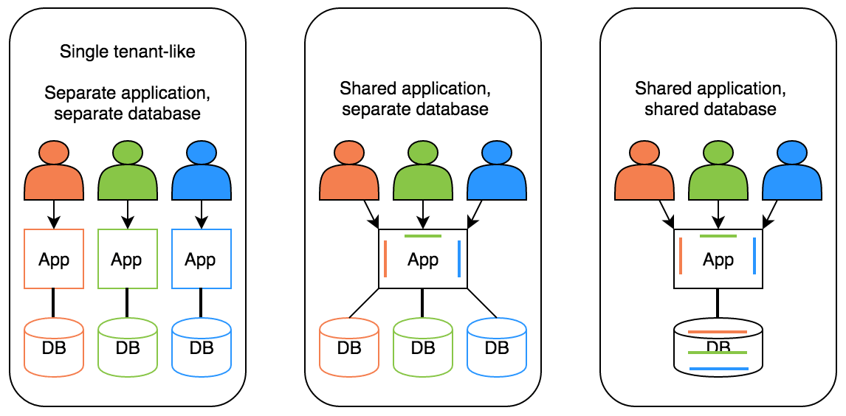
DEPLOYMENT / DATABASE OPTIONS
Hybrid!

Slide 8
IMPLEMENTING A MULTI-TENANT INFRA
Determining & changing the current tenant
Isolating & filtering database & cache
Temporary enable/disable multi-tenancy
Migrating databases
A feature system

Slide 9

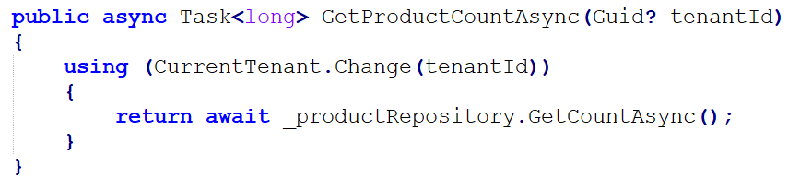
DETERMINE THE CURRENT TENANT
Sources
Current claims (for authenticated users)
Subdomain/domain example: https://tenant-name.mydomain.com
Others: HTTP header, cookies or query string
Obtaining the current tenant id: ICurrentTenant.Id

Slide 10
DATA ISOLATION
.

Slide 11
TITLE
.

Slide 12
TITLE
.

Slide 13
TITLE
.

Slide 14
TITLE
.

Slide 15
TITLE
.

Slide 16
TITLE
.

Slide 17
TITLE
.

Slide 18
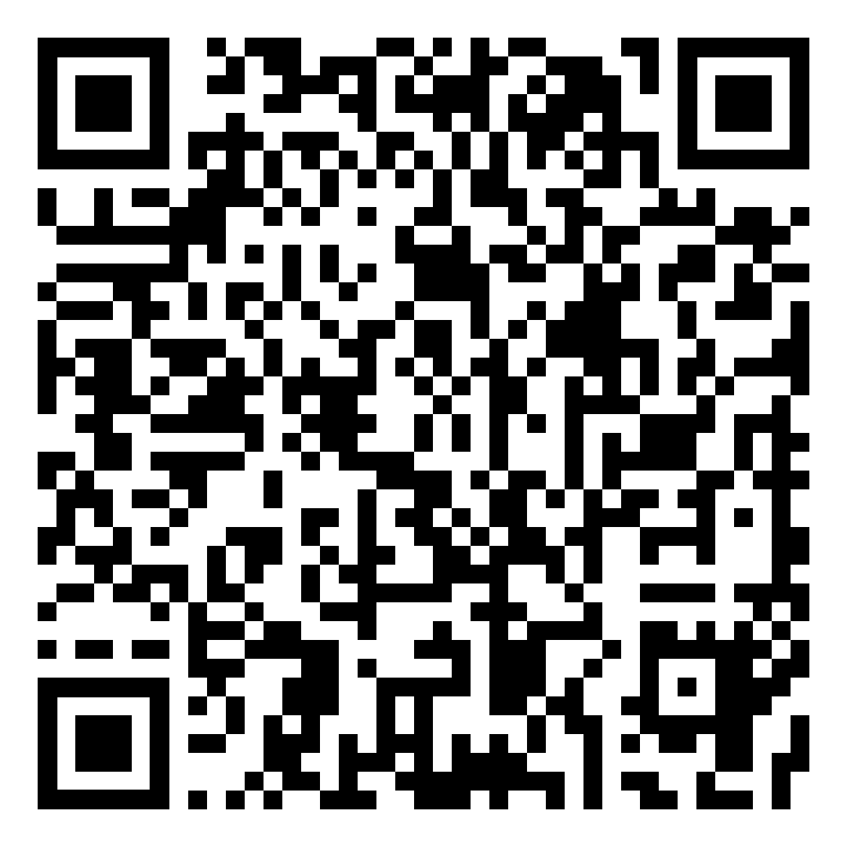
THANKS FOR
LISTENING
get the presentation
Halil İbrahim KALKAN
Co-founder & Lead Architect at Volosoft
hibrahimkalkan
hikalkan

